Slide 1
Exploration of the Mars Polar Atmosphere Using the Mars Climate Sounder (MCS) and the Ensemble Mars Atmosphere Reanalysis System (EMARS)
Hartzel Gillespie, Steven Greybush, Daniel McCleese, Armin Kleinböhl, David Kass, John Wilson and John T. Schofield
Penn State, Synoptic Science, JPL, and NASA-Ames
August 16, 2018

Slide 2
Outline
MCS and EMARS background
Climatological polar structure
CO₂ latent heating
Thermal tides
Ice and ice transport

Slide 3
Rationale
Building on prior study of transient eddies, we are interested in further characterizing the spatiotemporal variability of the Martian atmosphere.
Study of the Martian atmosphere may help us understand Earth’s atmosphere more.

Slide 4
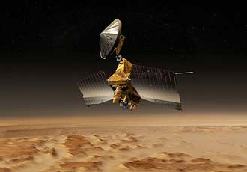
Mars Climate Sounder (MCS)
Limb-observing Sun-synchronous polar orbiter
20 vertical degrees of freedom, from the surface to 120 km
Along-track and cross-track observations
Temperature from MCS assimilated
Horizontal dust derived from MCS
(Montabone et al., 2015)
Concept art courtesy of NASA/JPL

Slide 5
Ensemble Mars Atmosphere Reanalysis System (EMARS)
Geophysical Fluid Dynamics Laboratory (GFDL) Mars Global Circulation Model (MGCM) (Wilson et al., 2002)
Grid spacing 5° by 6° (~150 km), with 28 vertical levels
Aerosols advected by model in both horizontal and vertical
Local Ensemble Transform Kalman Filter (Hunt et al., 2007)
16 ensemble members, water ice and dust varied among members

Slide 6
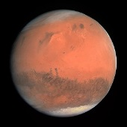
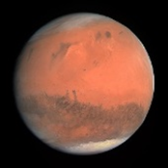
Time on Mars - Areocentric Longitude (Ls)
Autumnal equinox
Ls 180°
Ls 270°
Ls 90°
Northern winter solstice
Northern summer solstice
Ls 0°
Ls 360°
Vernal equinox

Slide 7
Time on Mars - Areocentric Longitude (Ls)
Autumnal equinox
Ls 180°
Ls 270°
Ls 90°
Northern winter solstice
Northern summer solstice
Ls 0°
Ls 360°
1° Ls ≈ 2 sols (Martian days)
Vernal equinox
Notes:
Focusing on MY 30, Ls 270

Slide 8
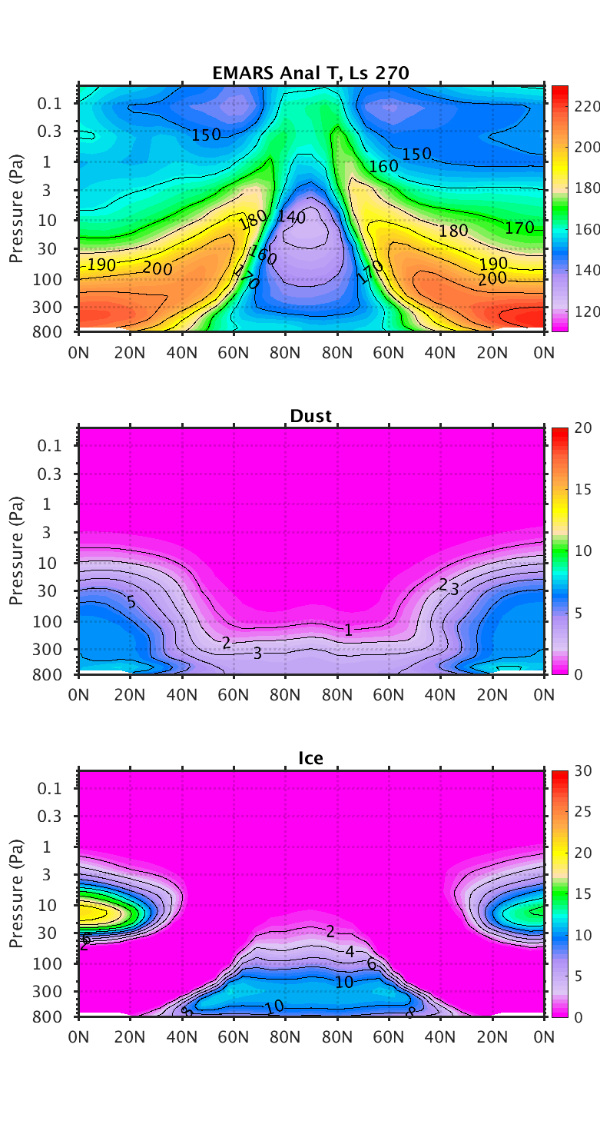
Climatological polar structure
Data from 3 AM and 3 PM local time in EMARS are retained
Zonal mean over 20 sols of EMARS, centered on Ls 270 (northern winter solstice)
3 AM is on the left, and 3 PM is on the right
MCS plots are similar, but are averaged over 5 Ls (about 10 sols)

Slide 9
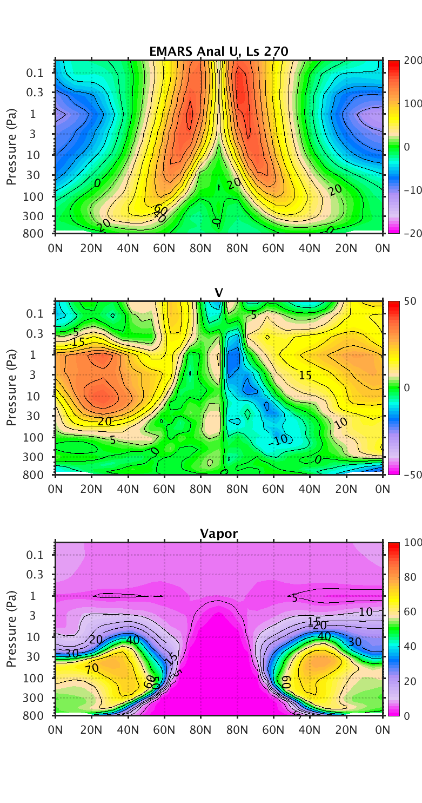
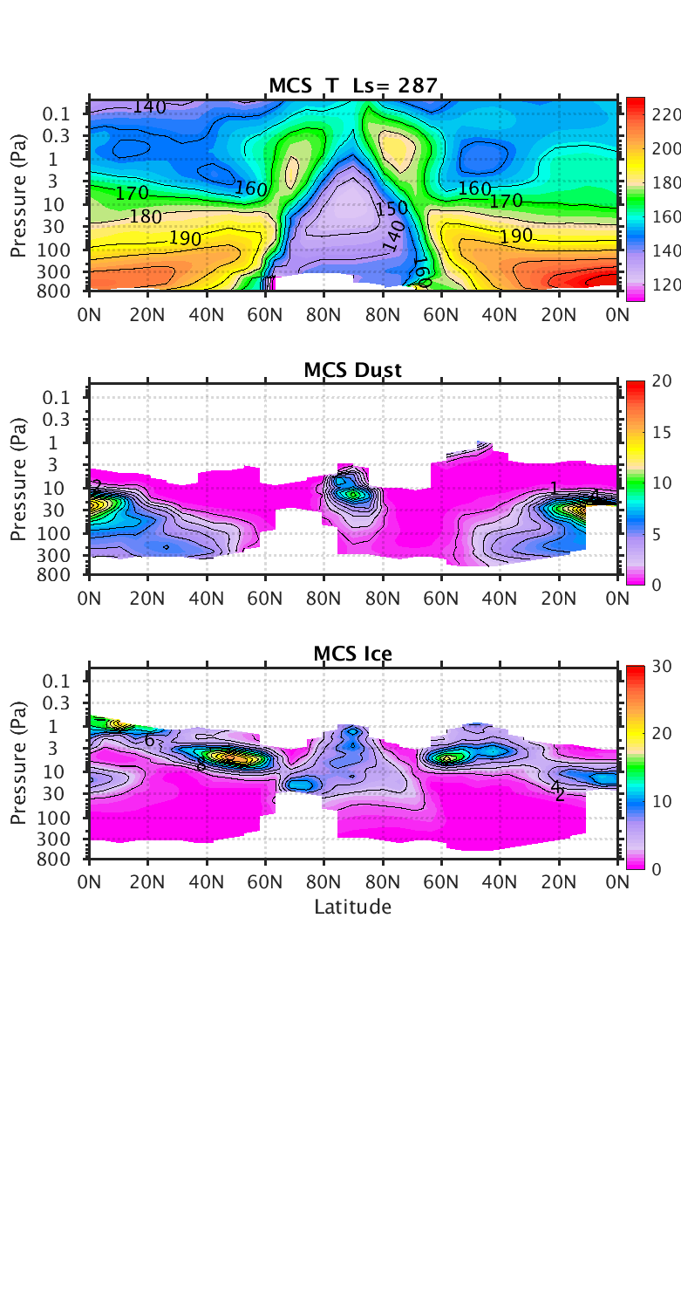
Notes:
Keep in mind that the MCS plot and the EMARS plots have different aspect ratios.

Slide 17
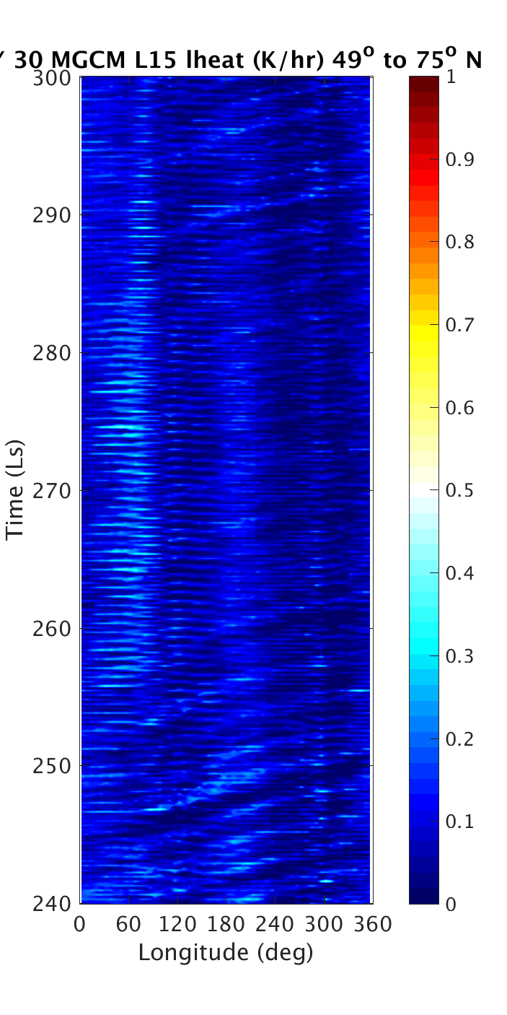
CO₂ latent heating
Hovmöller diagrams, with increasing time ascending instead of descending
EMARS data from one model level and a range of latitudes specified on the plot are plotted
Here, the largest value of CO₂ latent heating between 49 and 75 N is plotted at each longitude
1° Ls ≈ 2 sols (Martian days)

Slide 18
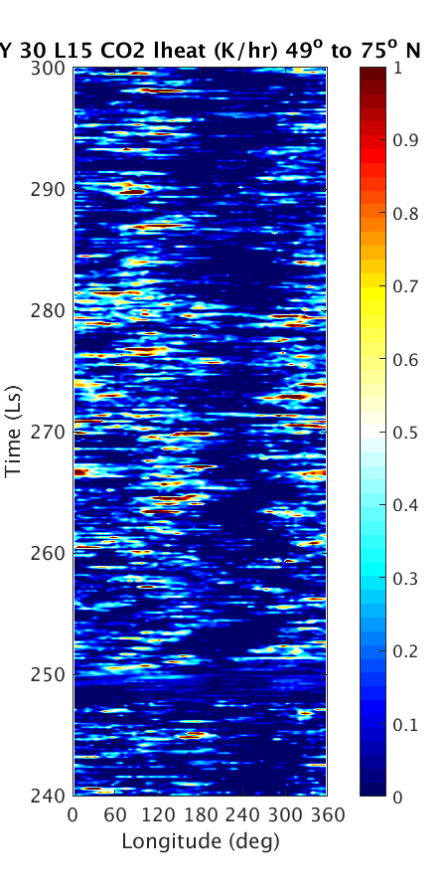
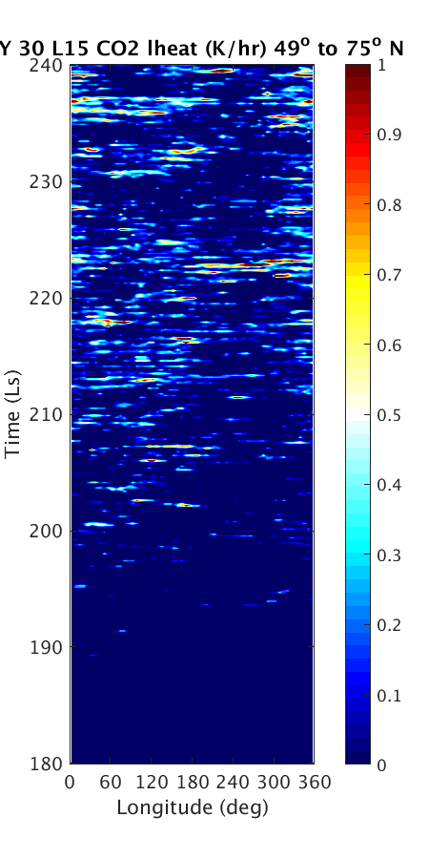
EMARS CO₂ latent heating
Vertical coordinate: σ ~ 0.3 (200 Pa, or 12 km)
The amount of time between each burst of latent heating seems to be close to 1 sol. A stationary wave of wavenumber 2 is apparent, but it’s hard to discern any horizontal motion of a latent heating anomaly.

Slide 19
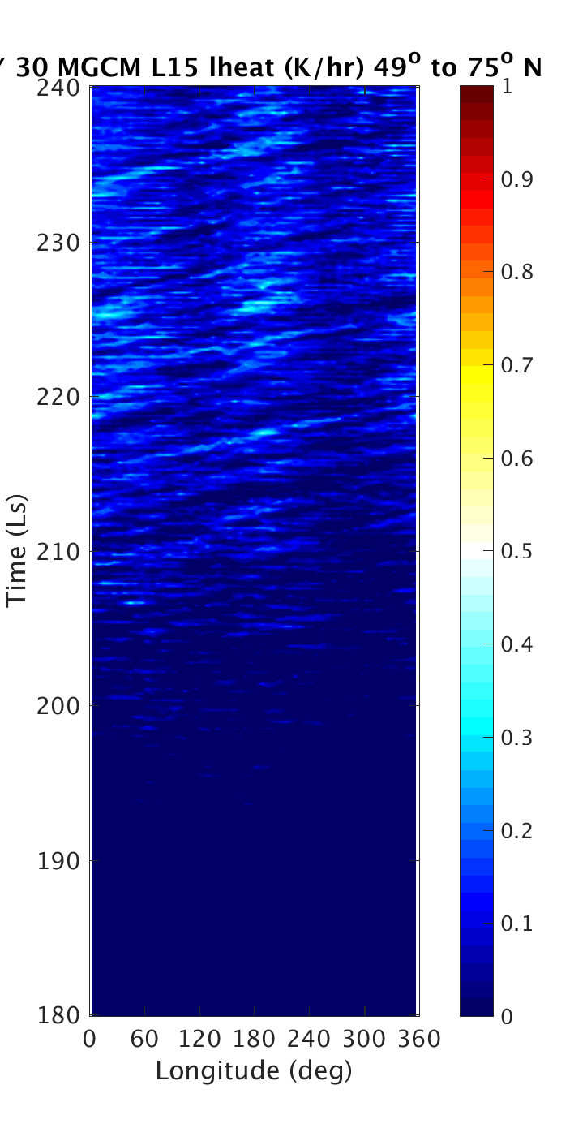
MGCM CO₂ latent heating
Vertical coordinate: σ ~ 0.3 (200 Pa, or 12 km)
In the model, the latent heating is a superposition of a tidal influence, a stationary wave, and transient eddies. Latent heating occurs primarily near 60 E and 200 E here, while in EMARS, 120 E and 330 E were the maxima.

Slide 20
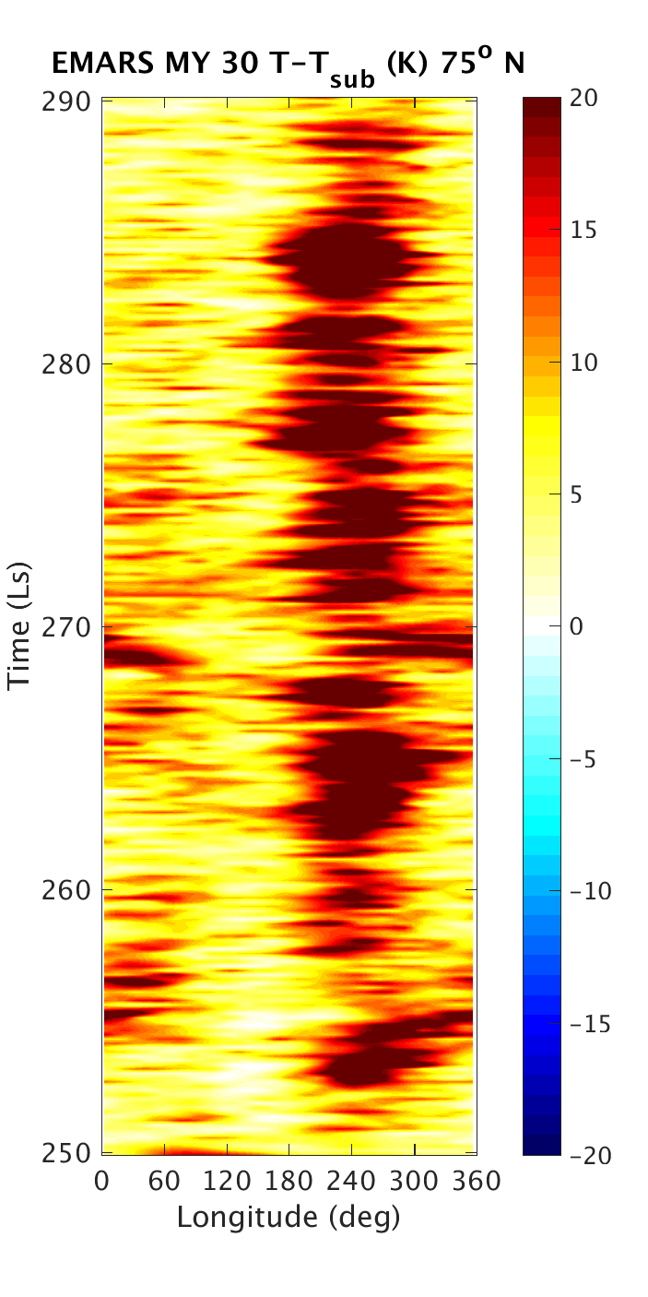
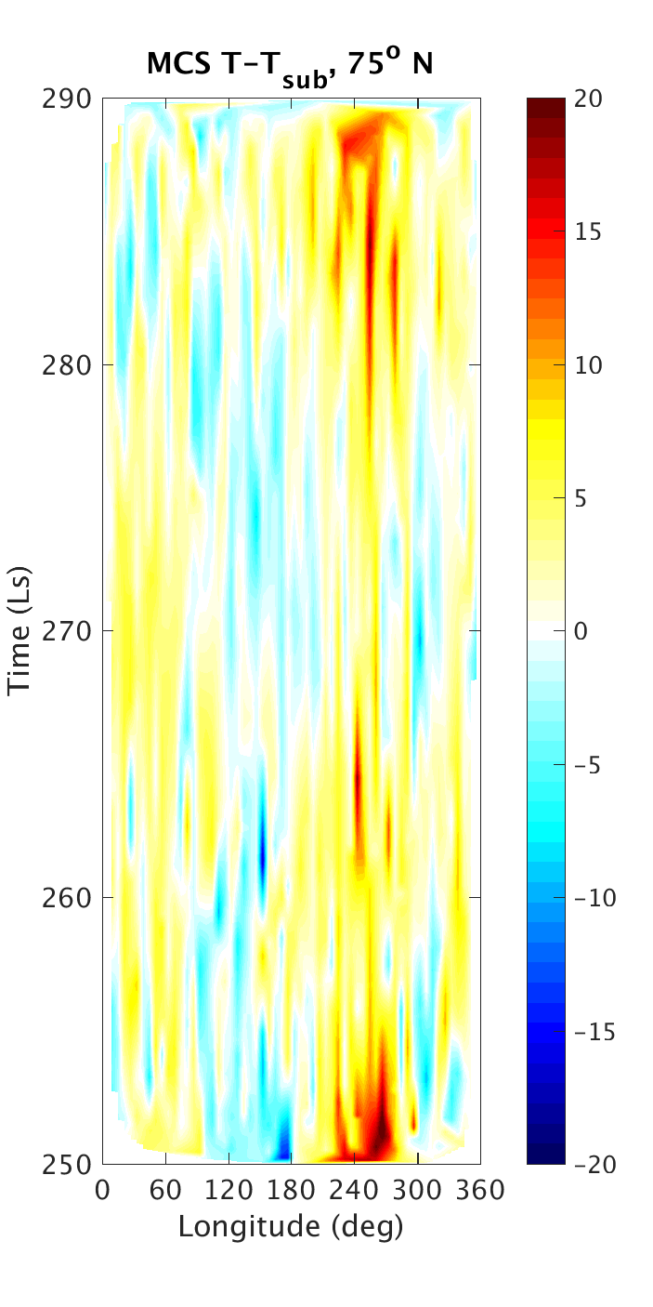
Difference between EMARS and MCS temperature and sublimation temperature of carbon dioxide at 80 Pa (22 km)
A stationary wave that appears to be a combination of wavenumbers 1 and 2 are present. Transient eddy activity is more difficult to discern, if it is present. Notice that the EMARS and MCS temperature difference minima are at similar longitudes.

Slide 21
Thermal tides

Slide 22
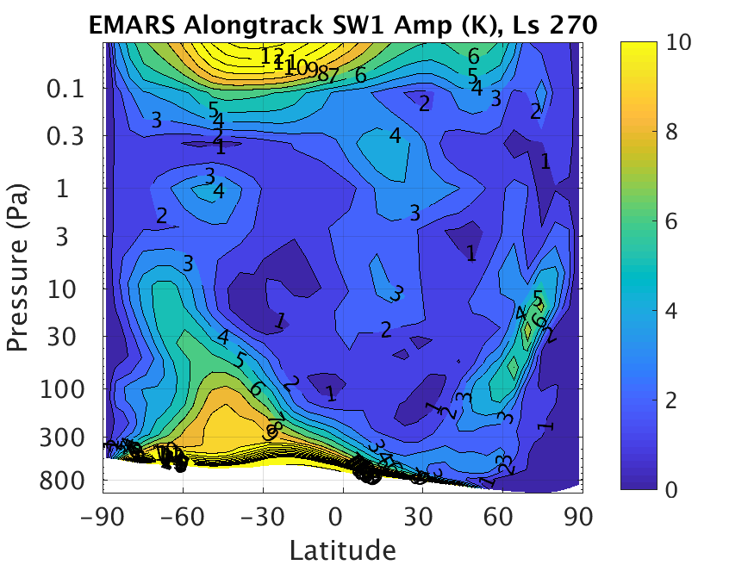
EMARS reproduces expected features of the diurnal tide amplitude, such as the large near-surface diurnal tide and greater amplitudes in the summer hemisphere than the winter hemisphere.

Slide 23
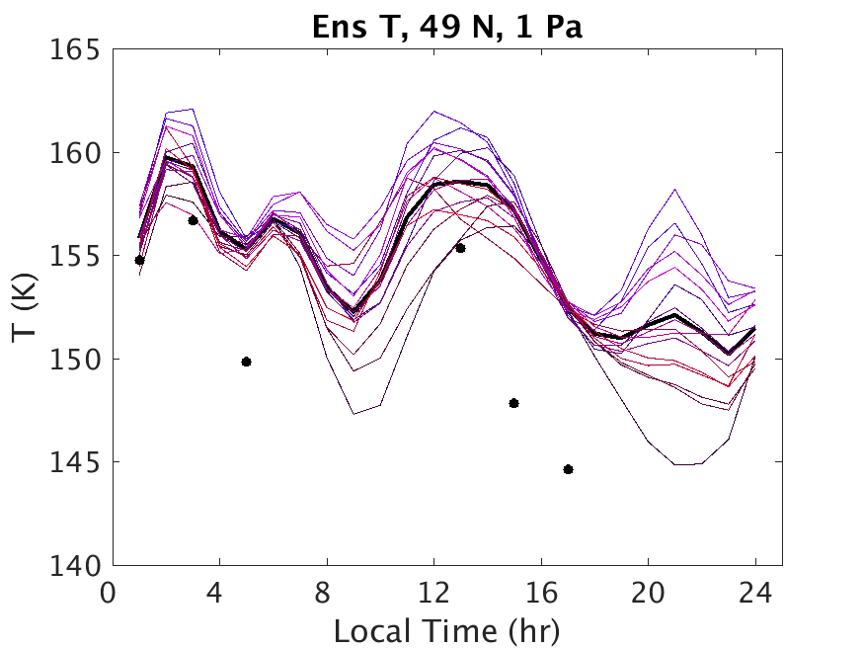
The thick black curve is the ensemble mean over 10 sols centered on Ls 270, the dots are the means of MCS observations, and the thin lines are ensemble members. Ensemble members are colored according to their dust and ice radiative factors.
Black → red: more dust
Black → blue: more ice

Slide 24
Ice and ice transport

Slide 25
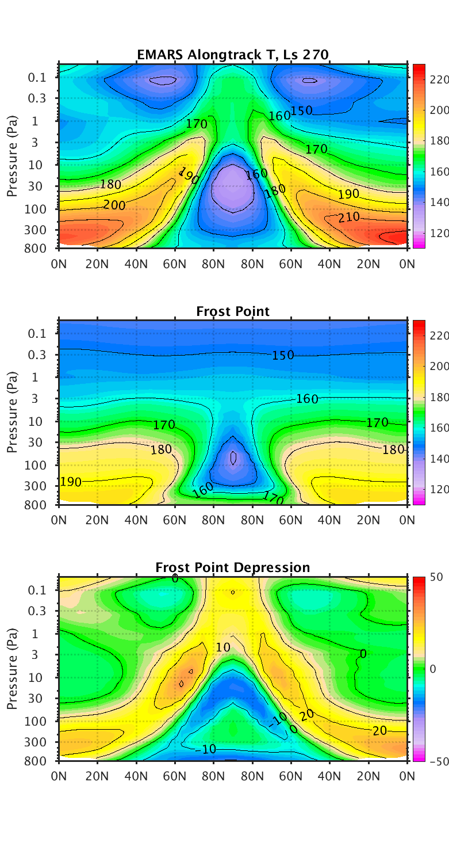
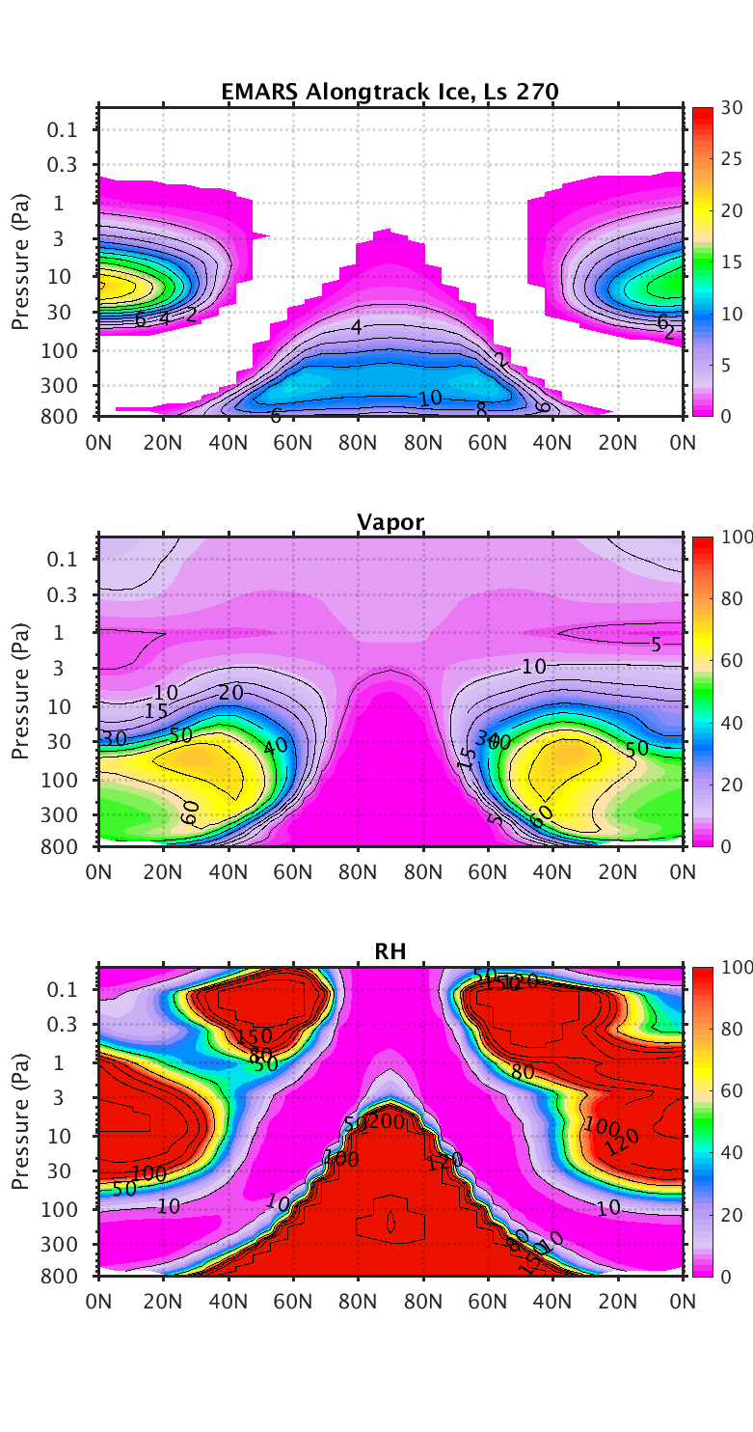
Ice values below 0.1 mg/kg not shown
The polar vortex is saturated.
Where the frost point depression is negative, we expect deposition of water vapor, but there are no clouds in the assimilation near the model top between 40 and 60 N.
Notes:
The polar vortex is saturated, despite the vapor mixing ratio being so small. The frost point depression also becomes quite negative within the vortex.
Where the frost point depression is negative, we expect deposition of water vapor. It is interesting that there are no clouds in the assimilation near the model top between 40 and 60 N. The ice mixing ratio is quite small at the top of the polar vortex, despite the very negative frost point depression.

Slide 26
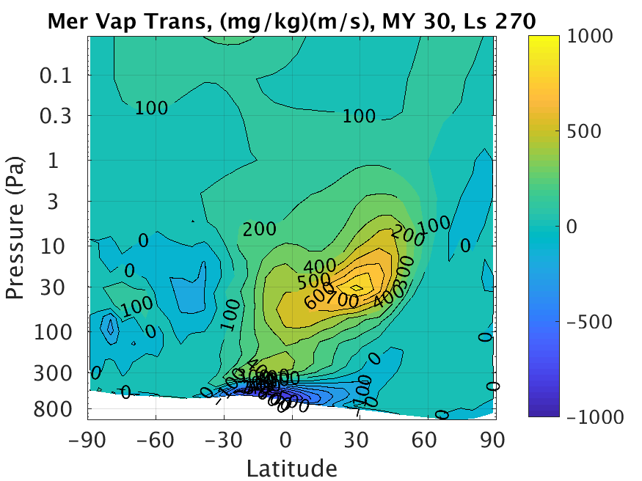
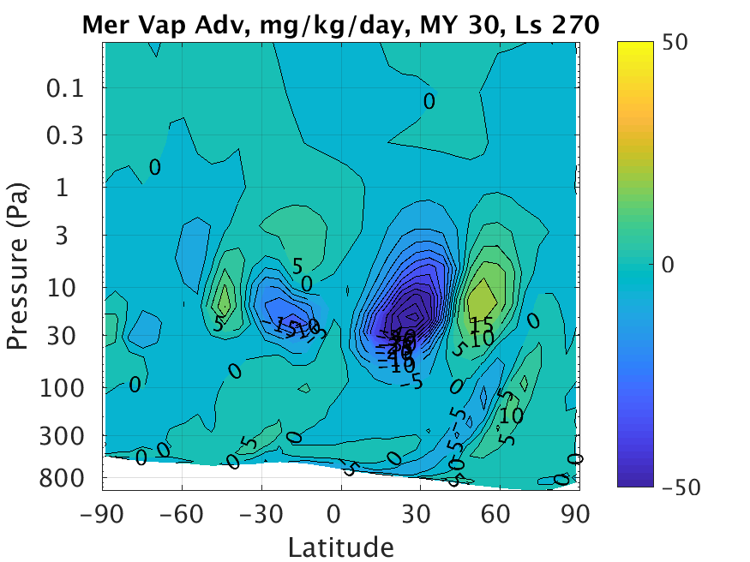
The left plot is vapor transport by meridional wind, while the right plot is vapor advection by meridional wind, as a 20-sol zonal mean.
The most notable effect suggested by the two plots together is the movement of water vapor from 25 N to 50 N, at 20 Pa, by the meridional wind.
Notes:
The left plot indicates how much vapor is moving meridionally, relative to the amount of air that is doing so. The right plot indicates how much vapor is accumulating in various regions of the atmosphere due to the meridional wind.

Slide 27
The left plot is vapor transport by meridional wind, while the right plot is vapor advection by meridional wind, as a 20-sol zonal mean.
The most notable effect suggested by the two plots together is the movement of water vapor from 25 N to 50 N, at 20 Pa, by the meridional wind.
Notes:
The left plot indicates how much vapor is moving meridionally, relative to the amount of air that is doing so. The right plot indicates how much vapor is accumulating in various regions of the atmosphere due to the meridional wind.

Slide 28
Conclusions
The zonal mean structure of MCS and EMARS are quite similar, but some differences remain challenging to resolve.
EMARS and MCS identify similar stationary waves in CO₂ deposition.
The combination of dust and ice variation among the EMARS ensemble members and information about Martian tides from MCS may inform future Mars modeling decisions.
The interior of the Martian polar vortex is saturated, despite the low water vapor mixing ratio inside. Further investigation of the vortex, including how water enters and exits the vortex, seems promising.

Slide 29
Acknowledgments
Funded by NASA grants NNX11AL25G, NNX14AM13G and 80NSSC17K0690.
Work at the Jet Propulsion Laboratory, California Institute of Technology is performed under contract with NASA.

Slide 30
References
Greybush, S. J., R. J. Wilson, E. Kalnay, Y. Zhao, R. Hoffman, and T. Nehrkorn (2014), Ensemble Mars atmosphere reanalysis system (EMARS), Presented at the Fifth International Workshop on the Mars Atmosphere: Modelling and Observations, Jointly sponsored by the Centre National d’Etudes Spatiales and the European Space Agency, Oxford, U. K.
Hunt, B. R., E. J. Kostelich, and I. Szunyogh (2007), Efficient data assimilation for spatiotemporal chaos: A local ensemble transform Kalman filter, Physica D, 230, 112-126, doi:10.1016/j.physd.2006.11.008
McCleese, D. J., J. T. Schofield, F. W. Taylor, S. B. Calcutt, M. C. Foote, D. M. Kass, C. B. Leovy, D. A. Paige, P. L. Read, and R. W. Zurek (2007), Mars Climate Sounder: An investigation of thermal and water vapor structure, dust and condensate distributions in the atmosphere, and energy balance of the polar regions, J. Geophys. Res., 112, E05S06, doi:10.1029/2006JE002790.
Montabone, L., K. Marsh, S. R. Lewis, P. L. Read, M. D. Smith, J. Holmes. A. Spiga, D. Lowe, and A. Pamment (2014), The Mars Analysis Correction Data Assimilation (MACDA) Dataset V1.0, Geoscience Data Journal, 1, 2, 129-139, doi:10.1002/gdj3.13.
Montabone, L., F. Forget, E. Millour, R. J. Wilson, S. R. Lewis, B. Cantor, D. Cass, A. Kleinboehl, M. T. Lemmon, M. D. Smith, and M. J. Wolff (2015), Eight-year climatology of dust optical depth on Mars, Icarus, 251, 65-95, doi:10.1016/j.icarus.2014.12.034.

